Slide 1
Tablet
Alpha Prototype
Diogo, Lio, Ray, Jose, Sam and Cameron
Notes:
Cam

Slide 2

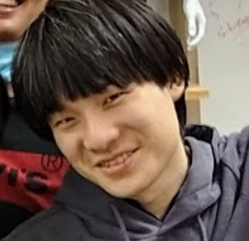




Team Intros
Lio Liang
Controls
Cam Mastoras
Team Lead
Yujui Chen
Electronics
Diogo Costa
Magnet
Samuel Petralia
CAD/Mechanical
Jose Amador
Magnet/Sourcing
Notes:
Cam

Slide 3
Process Bird’s Eye View
Team Splits Up For Testing
Alpha V1
Design
Review
Alpha V2
Design
Review
Challenge
Introduced
Alpha
Design
V1
Alpha
Design
V2
Beta
Design
1-DOF
Generating Reqs
Conceptualizing
Mechanism
Testing Phase
Demo
Alpha Build
Complete,
Alpha Demo
Beta Build
Complete!
WQ Week 1
SQ Week 10
Notes:
Cam
Red == You are here!

Slide 4
Road Map
Process & Background
Technical Details
Demonstration
Beta Thoughts
Challenge Overview
Concept Phase
Testing Phase
Mechanical Design
Magnets
Electrical System
Control System
Notes:
Cam

Slide 5
Challenge Overview
Move 2 points around in a plane
Provide force to user through magnet
User can interact with various virtual objects through display
Robot can track location of 1 or 2 fingers
Notes:
Cam

Slide 6
Technical Requirements
Continuous 6N at the end effector
Moving speed up to 150 mm/s
Wall stiffness of 1N/mm
Notes:
Cam

Slide 7
Road Map
Process & Background
Technical Details
Demonstration
Beta Thoughts
Challenge Overview
Concept Phase
Testing Phase
Mechanical Design
Magnets
Electrical System
Control System
Notes:
Diogo

Slide 8
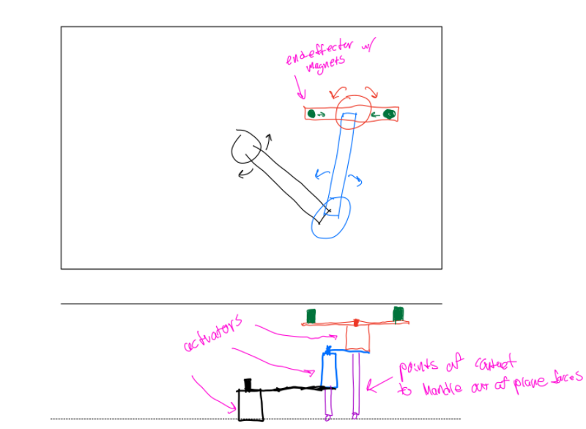
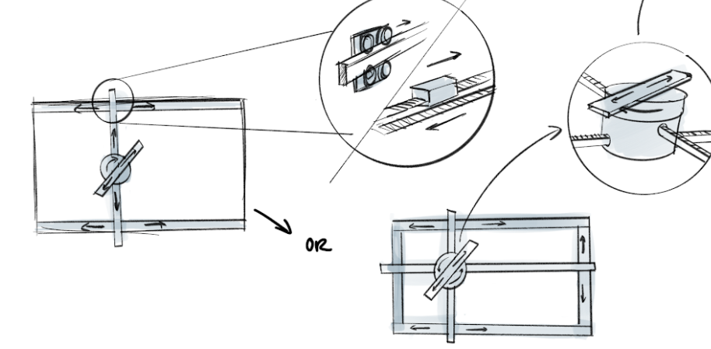
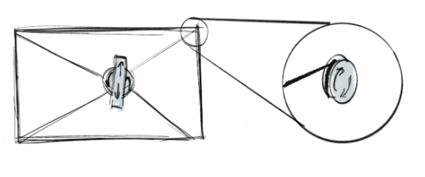
Concept Phase
Brainstorm different ways to achieve all DOF:
Gantry systems
Cable systems
Linkage systems
Notes:
Diogo

Slide 9
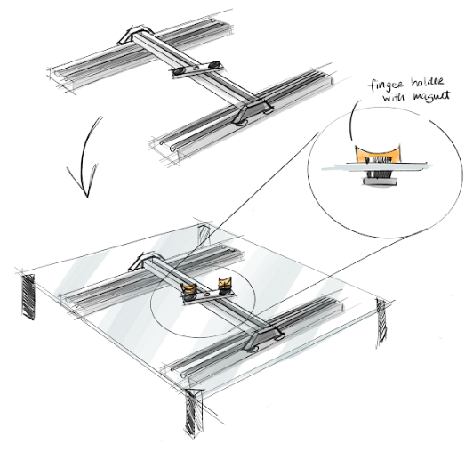
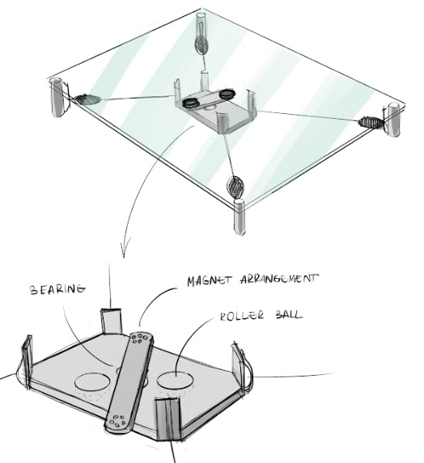
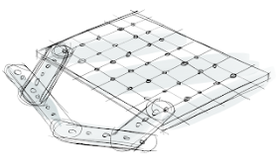
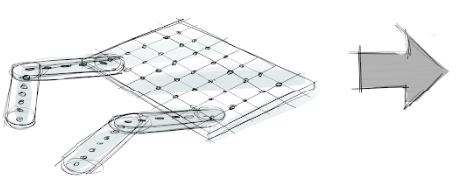
Concept Phase
Ideation of prototypes:
Gantry
Cable Bot
Open Linkage
Closed Linkage
Notes:
Diogo
Things we wanted to test:
Positional accuracy
Friction
Singularity
Envelope

Slide 10
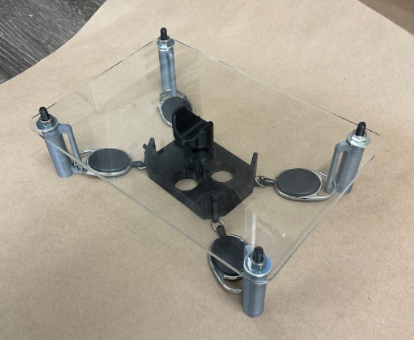
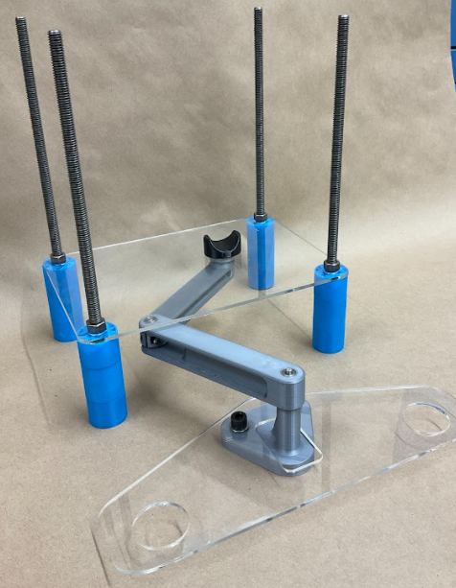
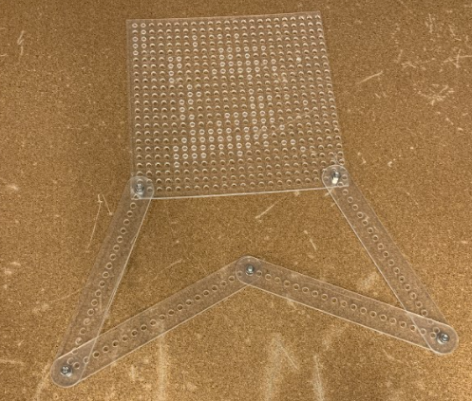
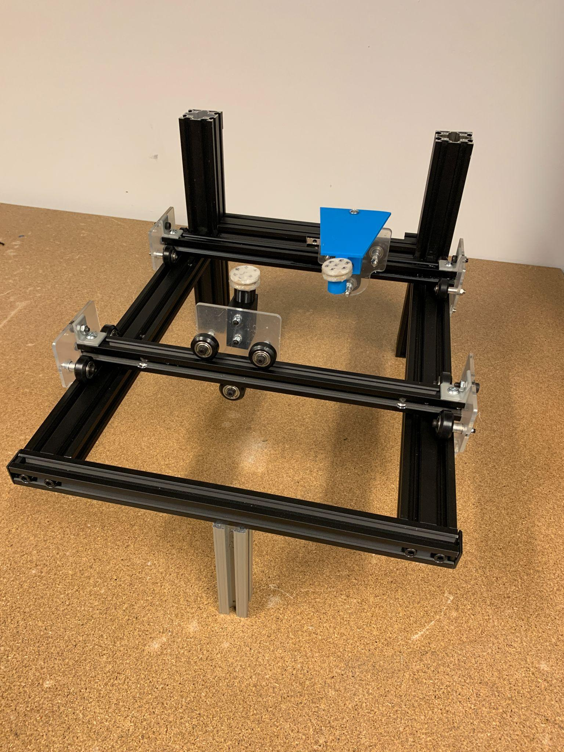
Concept Phase
Notes:
Diogo
Results of the prototype making - the results and conclusions from testing are in the next slides

Slide 11
Road Map
Process & Background
Technical Details
Demonstration
Beta Thoughts
Challenge Overview
Concept Phase
Testing Phase
Mechanical Design
Magnets
Electrical System
Control System
Notes:
Cam

Slide 12
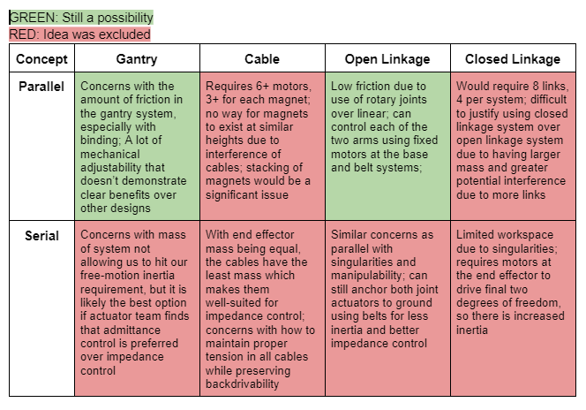
Mechanism
Narrowed the ideation to two concepts:
Parallel Gantry
Paralel Open Linkage
Notes:
Cam

Slide 13
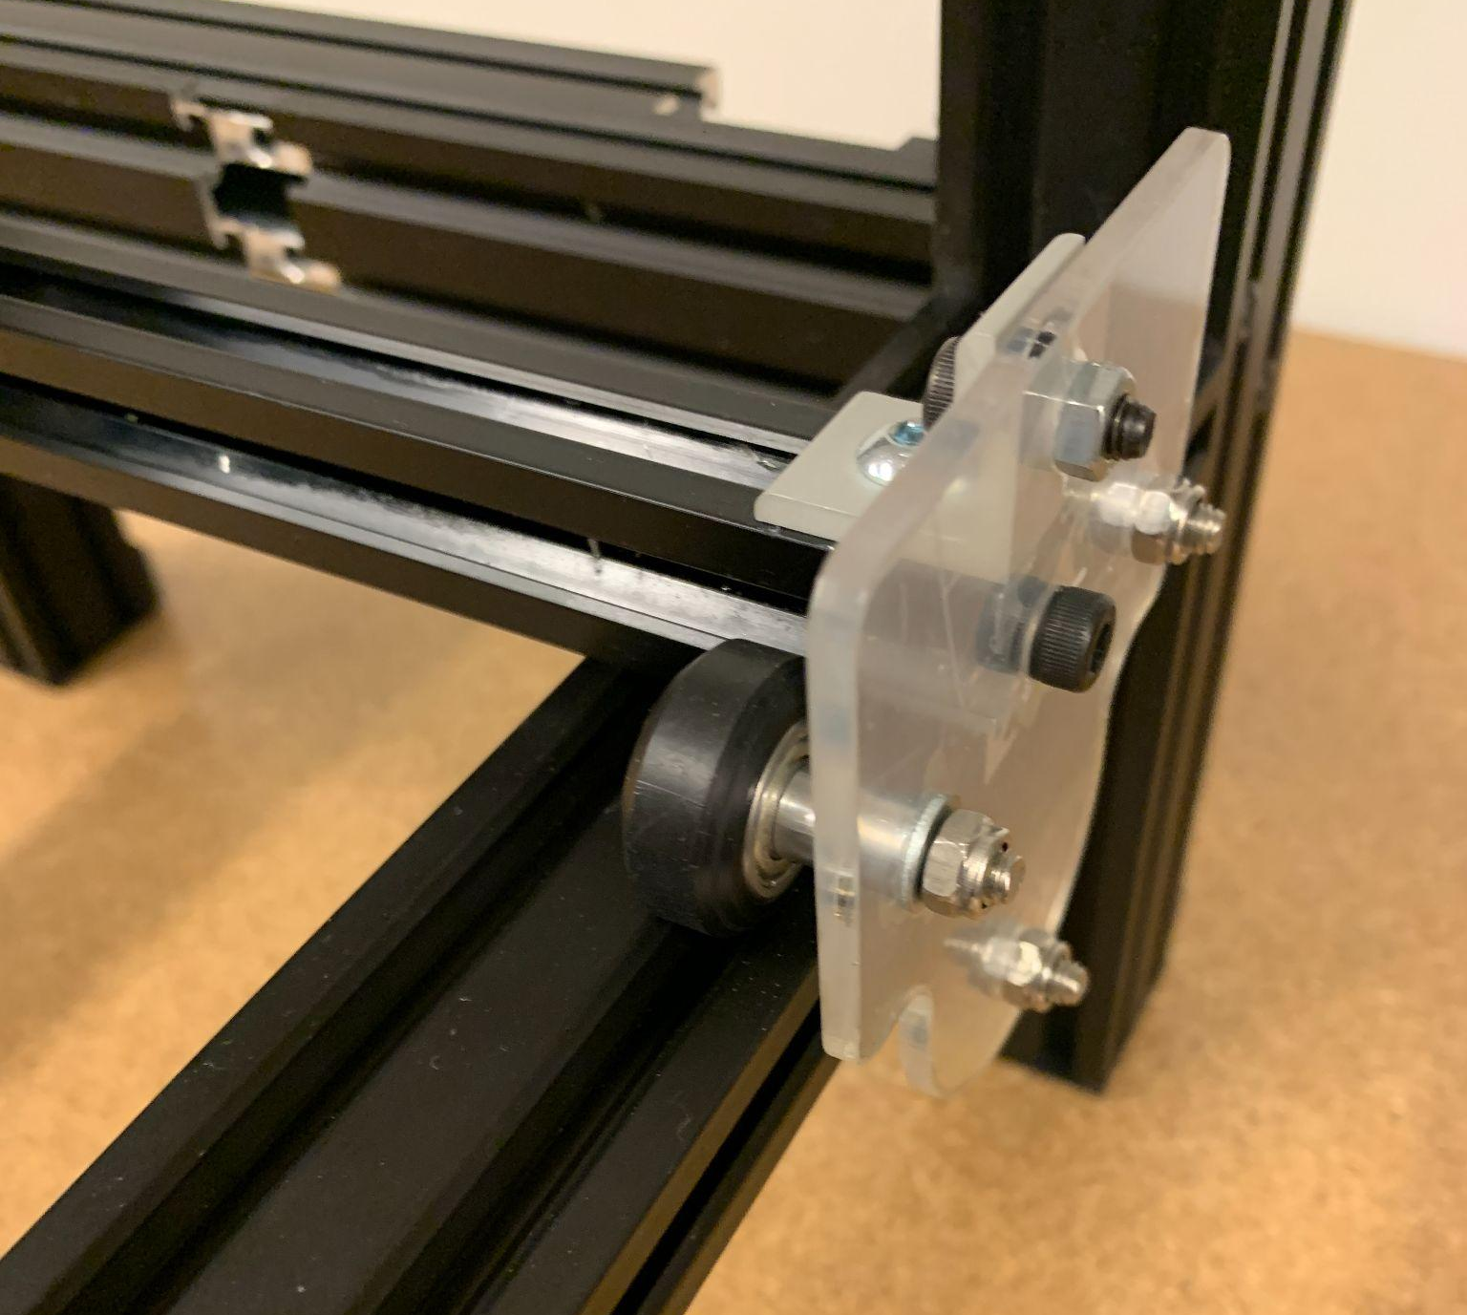
Mechanism
Notes:
Cam

Slide 14
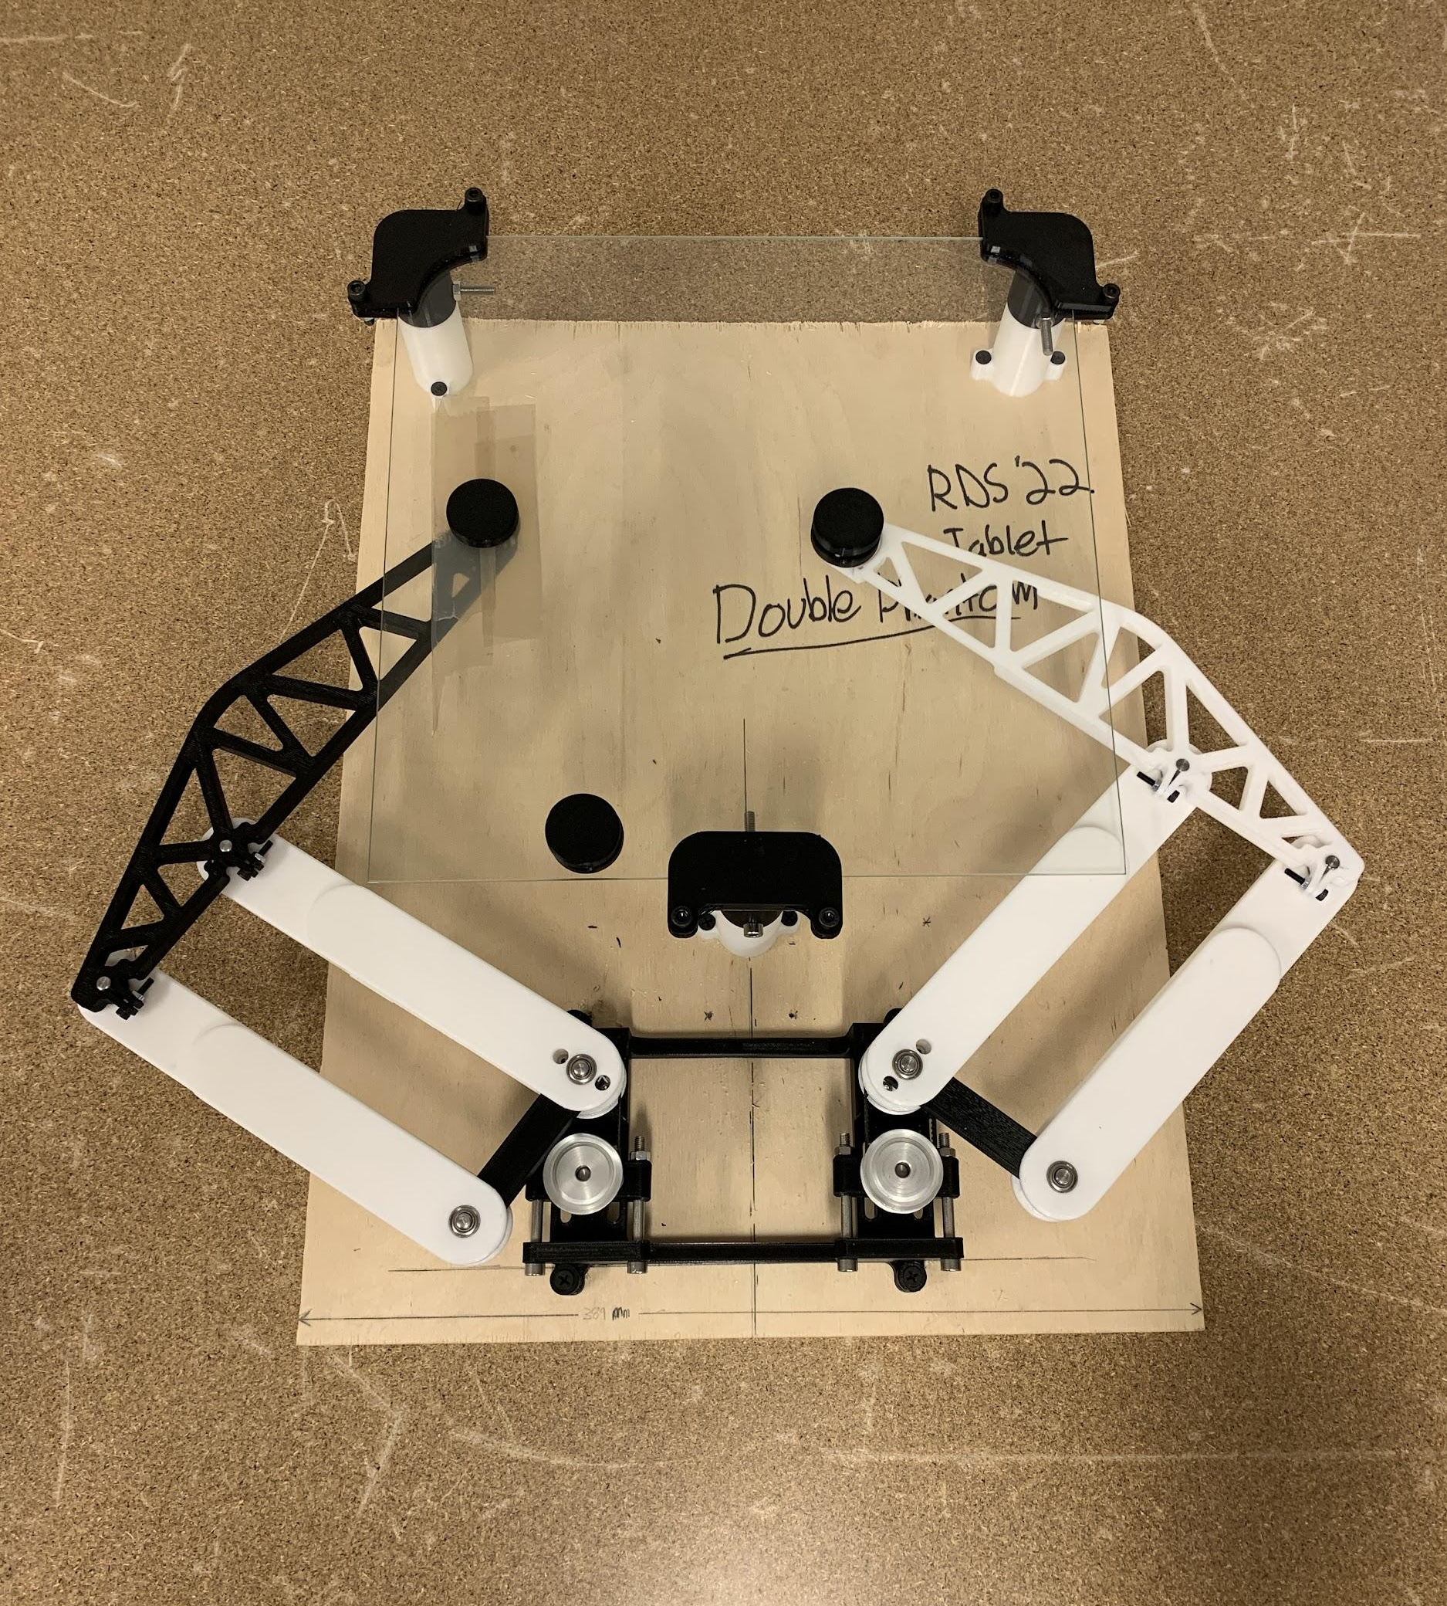
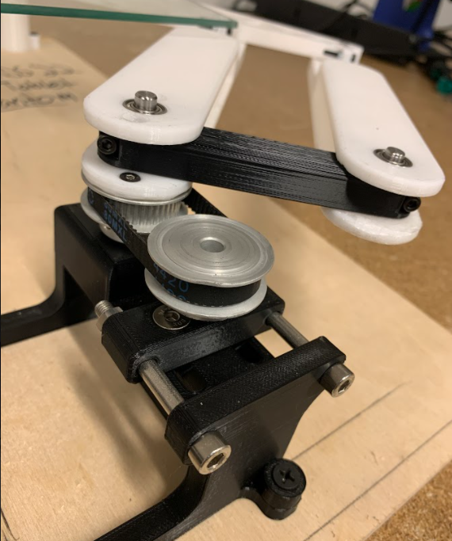
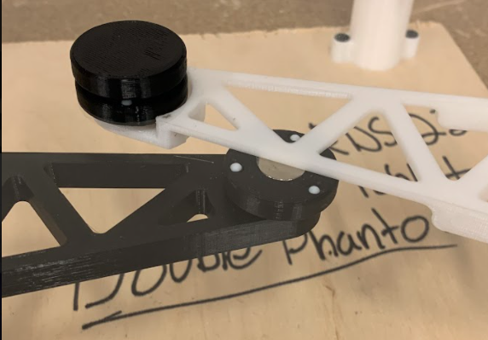
Mechanism
Notes:
Cam

Slide 15
Mechanism
Ultimately decided on two, 2R arms with parallel linkages
Easier to control friction at shafts w/ bearings than with rolling surfaces
Low inertia - motors mounted at base rather than on frame
Parallel design much more straightforward than in gantry system
Notes:
Cam

Slide 16
1-DOF
Gantry style
Presented quicker path to working demo by repurposing 3D printer components
Control system learnings applicable to any style of robot
Included magnet into design to begin to test how magnet interacts with virtual controller
Notes:
Cam

Slide 17
Road Map
Process & Background
Technical Details
Demonstration
Beta Thoughts
Challenge Overview
Concept Phase
Testing Phase
Mechanical Design
Magnets
Electrical System
Control System

Slide 18
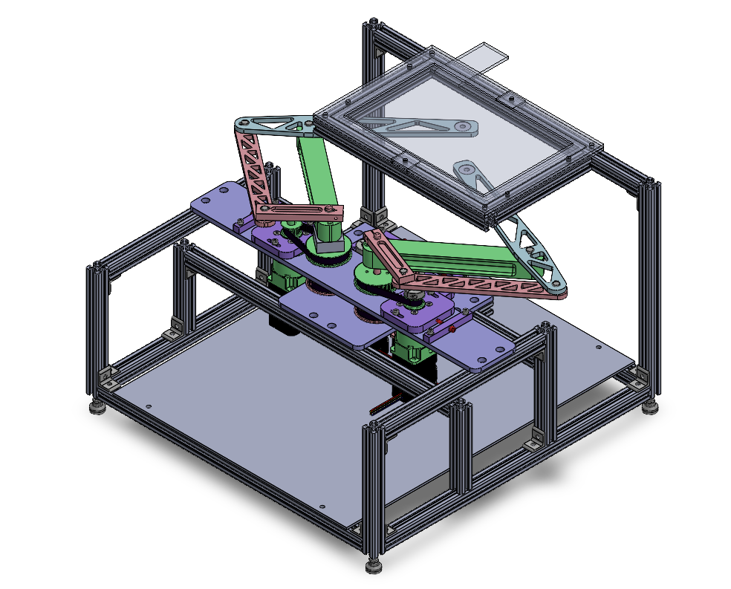
Design: Top Level
Touchscreen tablet
Symmetric phantom 2R linkages
Key Requirements
Continuous 6N at each end effector
Track fingers moving 150 mm/s
100 micron resolution of position at each end effector
User experiences 100 grams or less of inertia in free motion
20 mm profile 80/20 frame
Acrylic base plate
Transmission
Notes:
Sam

Slide 19
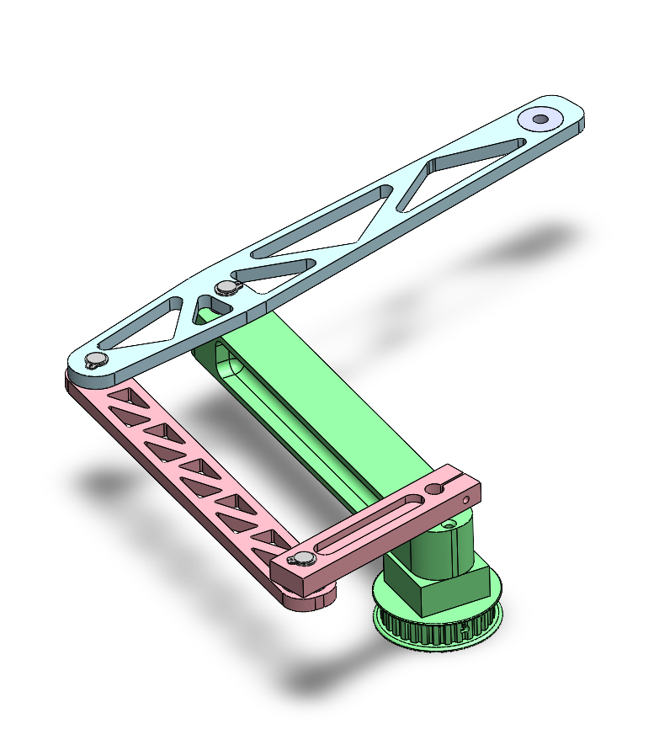
Design: Phantom Linkage
Pros
Commonly solved kinematics
Low inertia; all motors anchored to mechanical ground
Uses only revolute joints; minimal friction and chance of binding
Cons
Performs differently across workspace
Extends beyond workspace; doesn’t package cleanly
Added inertia from proximal and outer links
Distal link
Base link, provides out-of-plane stiffness
Proximal link
Outer link
All links made from AL6061
Notes:
Sam

Slide 20
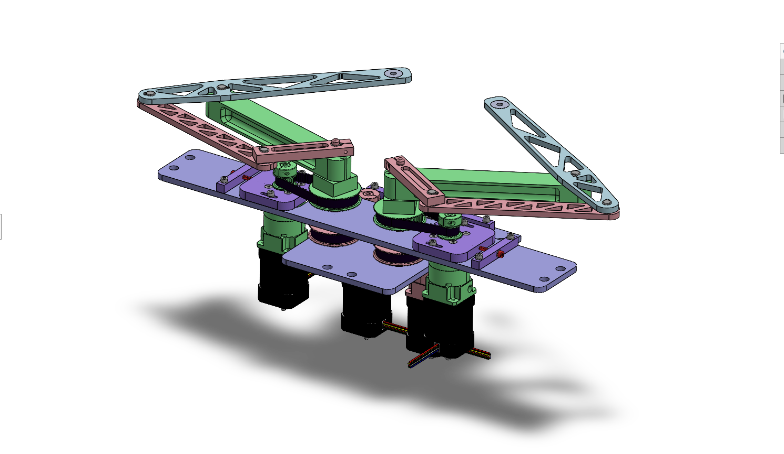
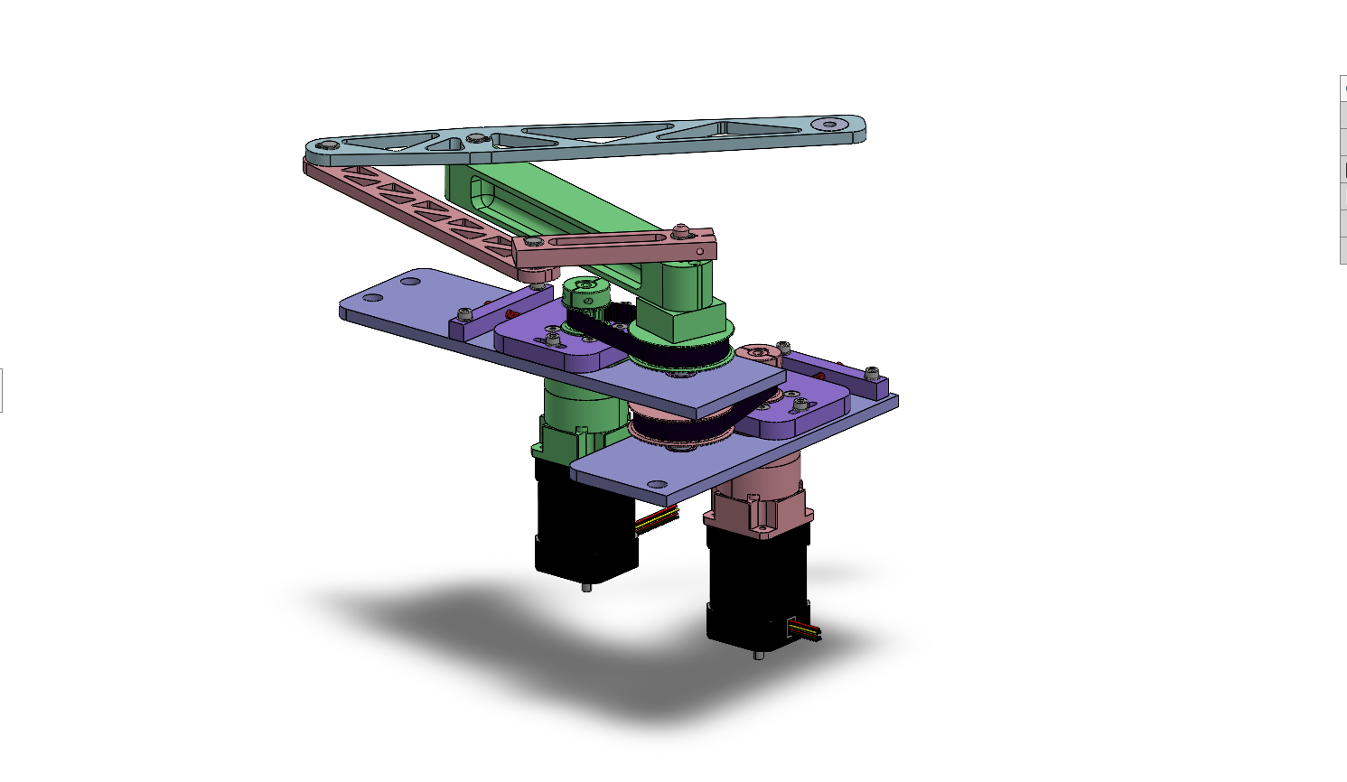
Design: Transmission
Common shaft / axis
2.5:1 XL timing belt reduction
2X 5:1 planetary gearbox
2X brushless DC motor
Notes:
Sam

Slide 21
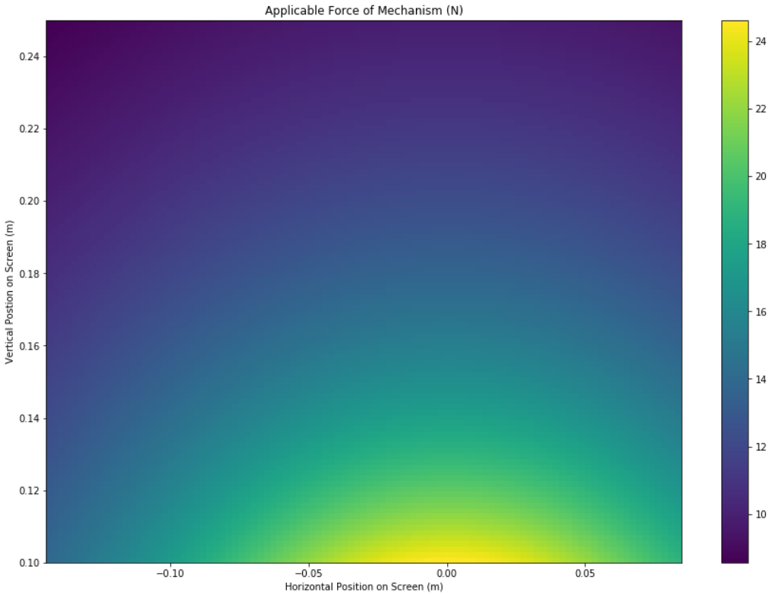
Transmission Component Selection
Rationale
6N required continuously at end effectors
High torque motor with 12.5:1 overall transmission reduction meets force requirement
Gearbox has 0.1 degrees of backlash, which is too much when projected to end-effectors
Include pulley reduction between gearbox and output shafts to reduce backlash at the end effectors
Results
Min. feasible output force: 8.5 N
Max. projected backlash: 0.31 mm
Max. reflected inertia: 32 g
Minimum Feasible Output Force Across Workspace (N)
*Detailed motor specs, gearbox specs, and other workspace color plots in reference slides
*For right-hand linkage
Notes:
Sam

Slide 22
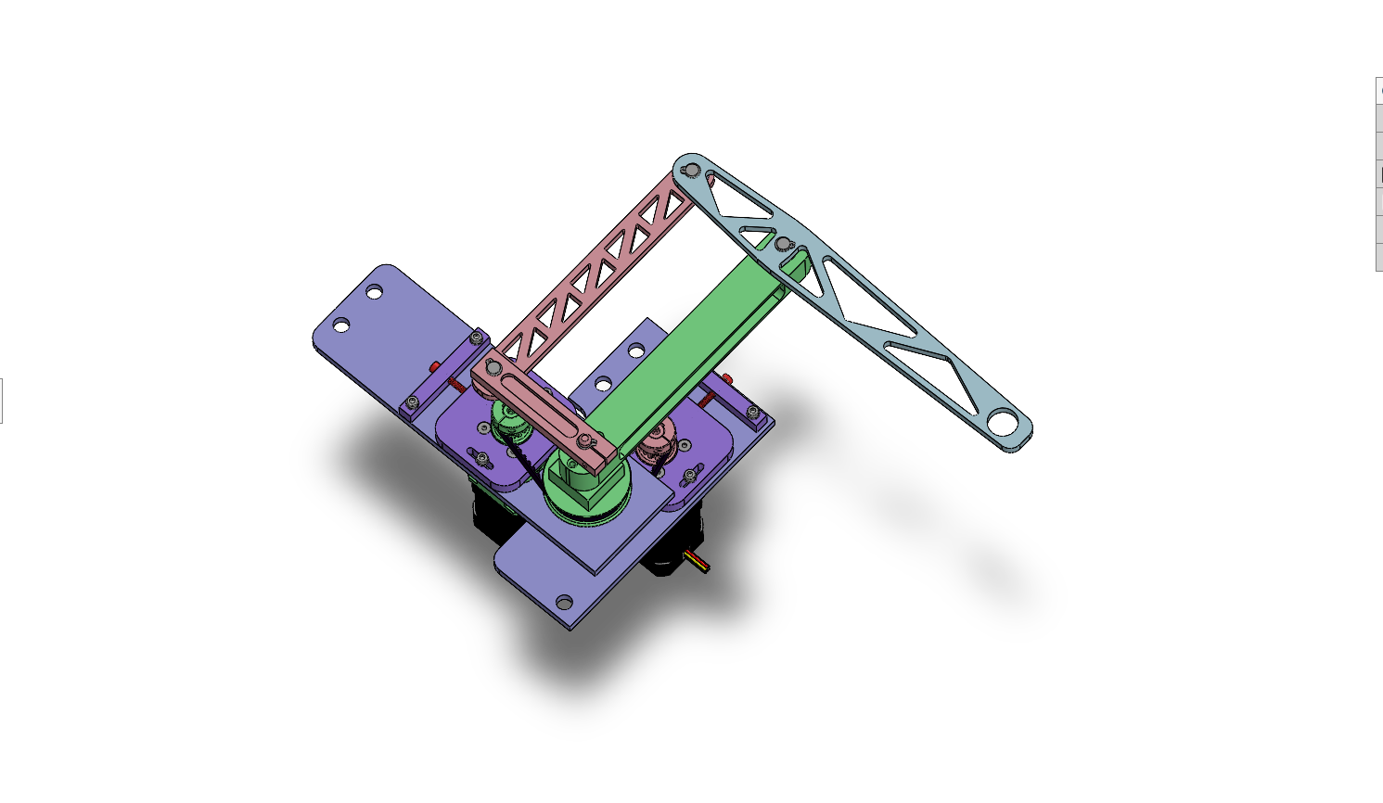
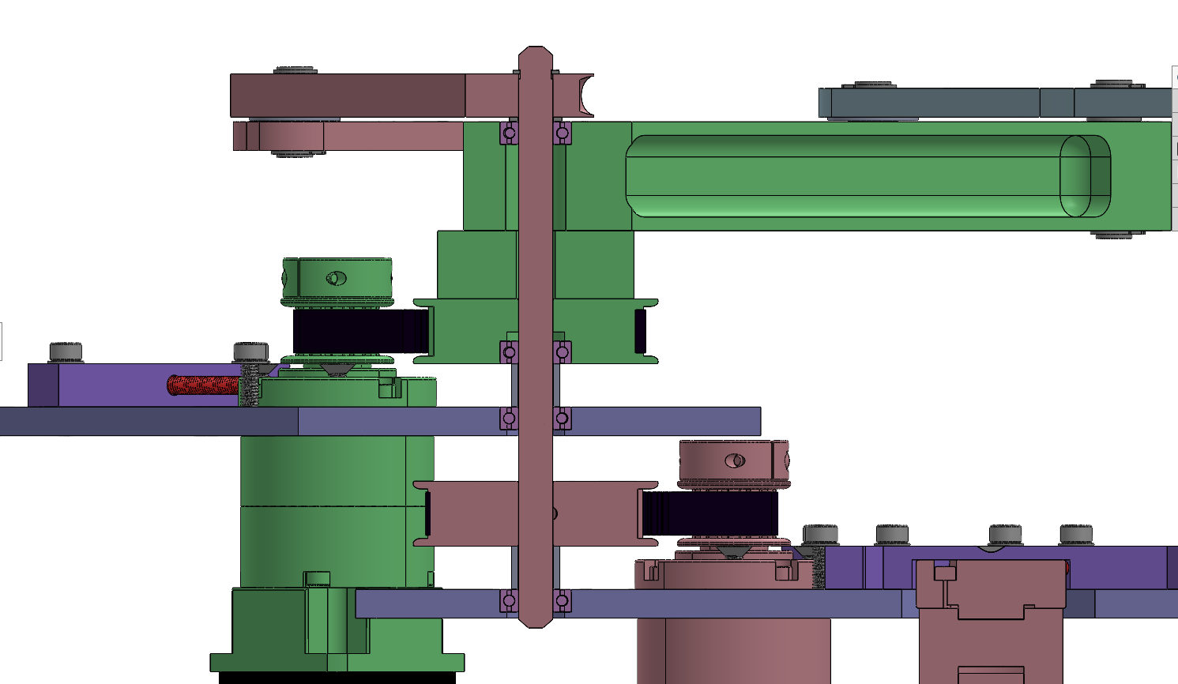
Shaft Stack: Common Axis
Proximal link- clamps to keyed shaft
4X radial ball bearing- friction fit in parent material
Active spacer- fastened to pulley and base link
8mm keyed steel shaft
2X Passive spacer- sits on inner race of bearing
2X AL6061 mounting plate
Timing belt pulley- keyed to shaft with friction fit
*Some components hidden for clarity
Notes:
Sam

Slide 23
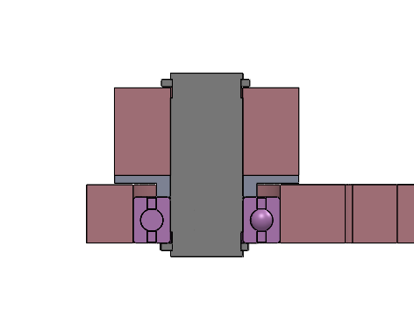
Shaft Stack: Proximal-Outer Axis
2X c-clip- provides axial retention
Proximal link
8mm steel shaft- tight slip fit with bearing and proximal link
AL6061 spacer- rests on bearing inner race
Radial ball bearing- friction fit with outer link
Outer link
Notes:
Sam

Slide 24
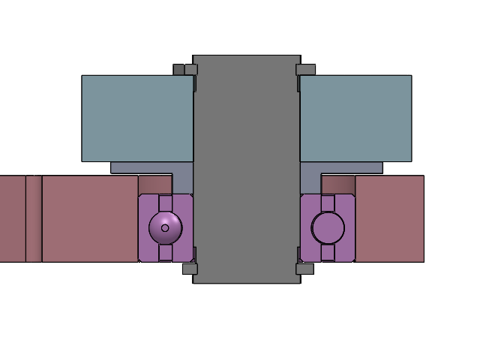
Shaft Stack: Distal-Outer Axis
2X c-clip- provides axial retention
Distal link
8mm steel shaft- tight slip fit with bearing and distal link
AL6061 spacer- rests on bearing inner race
Outer link
Radial ball bearing- friction fit with outer link
Notes:
Sam

Slide 25
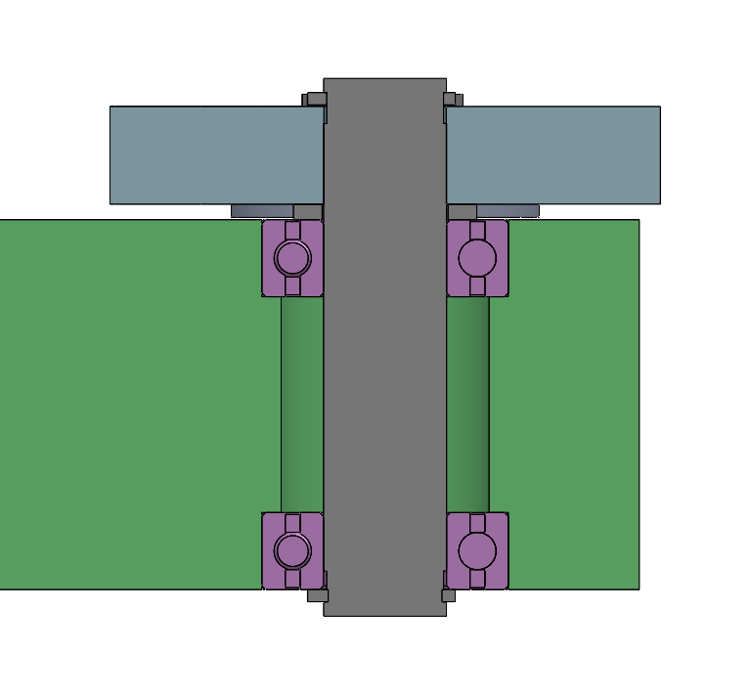
Shaft Stack: Base-Distal Axis
2X c-clip- provides axial retention
Distal link
AL6061 spacer- rests on bearing inner race
8mm steel shaft- tight slip fit with bearing and distal link
Base link
2X radial ball bearing- friction fit with base link
Notes:
Sam

Slide 26
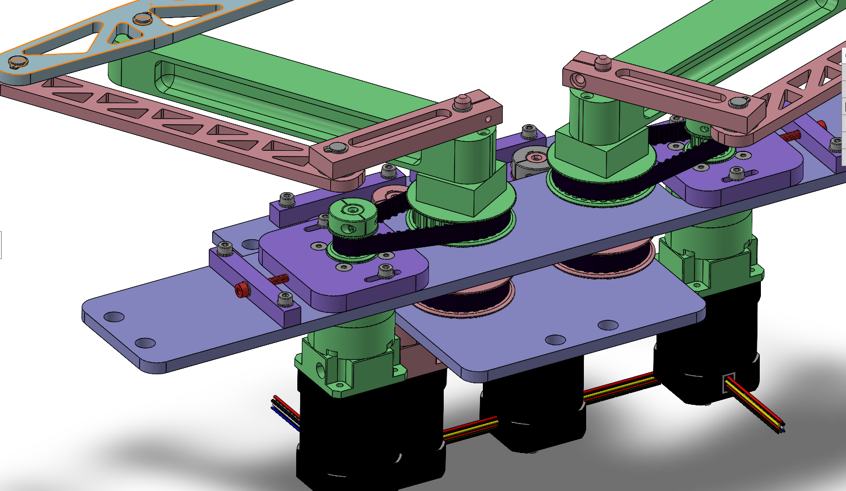
Design: Belt Tensioning
AL6061 tension bar- fixed to plate
Tighten red screw to apply tension to belt
AL6061 gearbox mount- slotted to allow for tensioning
Notes:
Sam

Slide 27
Design: Overview
Key Performance Specs
Min. feasible output force: 8.5 N
Max. projected backlash: 0.31 mm
Max. reflected inertia: 32 g
Mass of one phantom linkage: 0.6 kg
Notes:
Sam

Slide 28
Road Map
Process & Background
Technical Details
Demonstration
Beta Thoughts
Challenge Overview
Concept Phase
Testing Phase
Mechanical Design
Magnets
Electrical System
Control System
Notes:
Cam

Slide 29
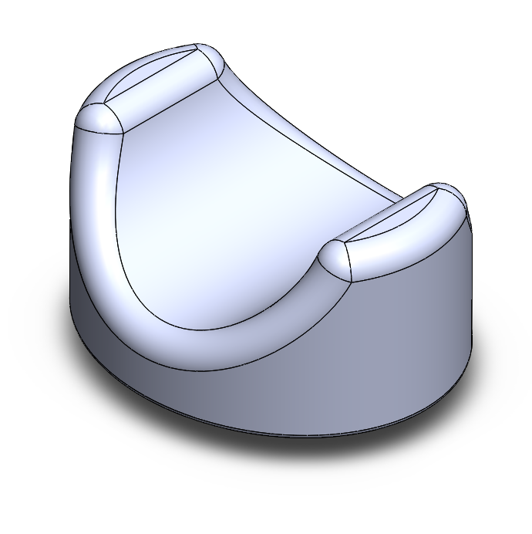
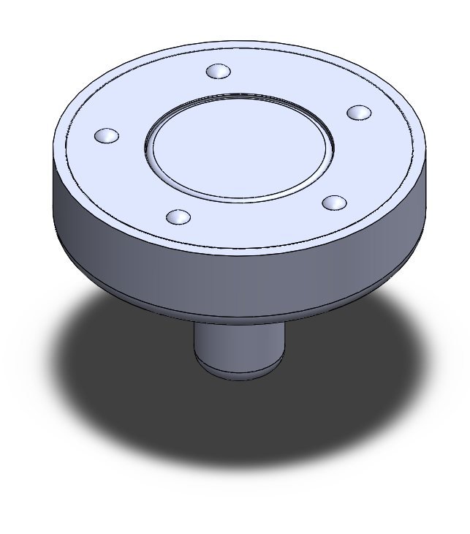
Design Focus: Magnet
LOW FRICTION:
In free motion, the user should experience no more than 0.22 lbs or 100 g of inertia.
Match finger speeds up to 150mm/s or 5.9 in/s
HIGH SHEAR STRENGTH:
When the user is interacting with a virtual wall, the device will be able to respond with a stiffness of 1 N/mm or 5.71 lbs/in
Notes:
Diogo

Slide 30
Design Focus: Magnet
KEY ISSUE: Friction and shear strength coupled
Many attempts to mitigate friction:
Air bearing
Teflon
Lubricant
Polymagnets
Height variants
Thrust bearings
Notes:
Diogo

Slide 31
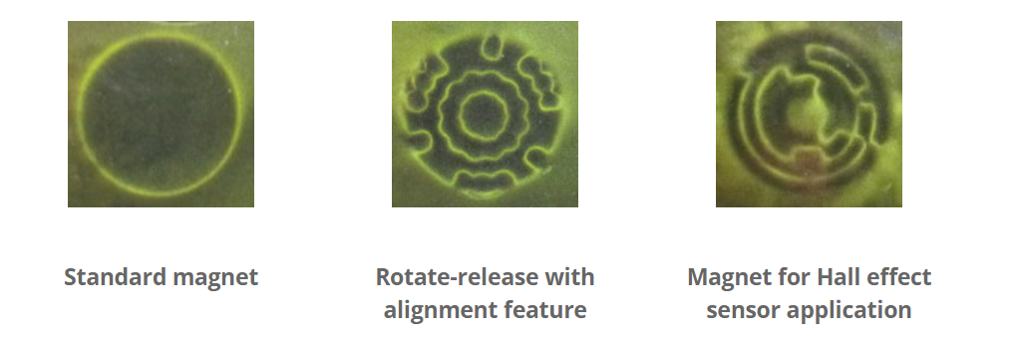
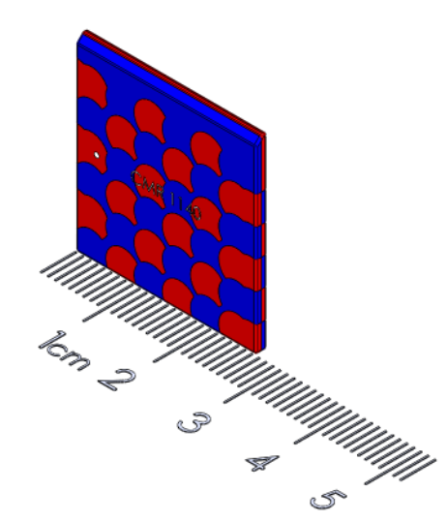
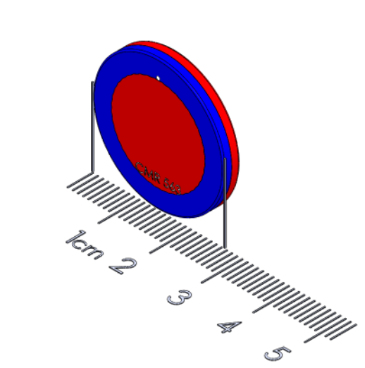
Polymagnets
Company that makes custom magnets to fit specific functions
Custom N/S patterns
Reached out for a consultation
Ordered a 20+ magnets

Slide 32
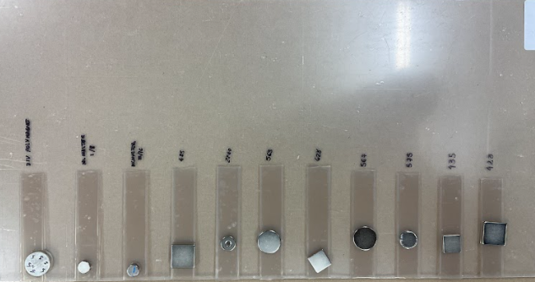
Testing
Tried different magnet combinations with different friction mitigation techniques
Grease
Teflon tape
Teflon balls
Qualitatively measured shear strength and friction
Results changed once the actual screen was introduced - much larger distance + different materials

Slide 33
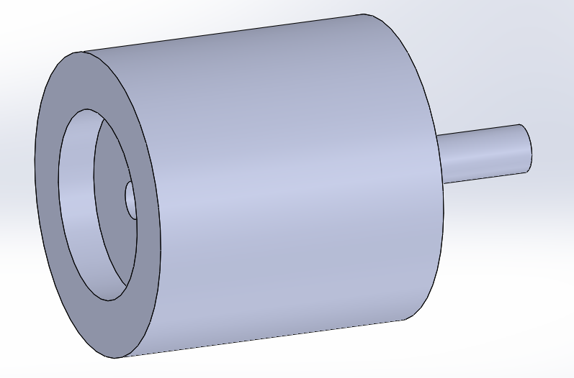
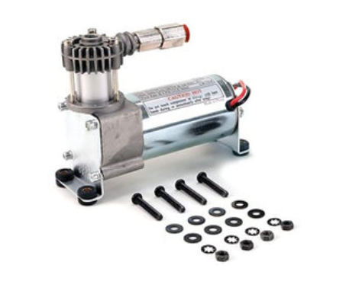
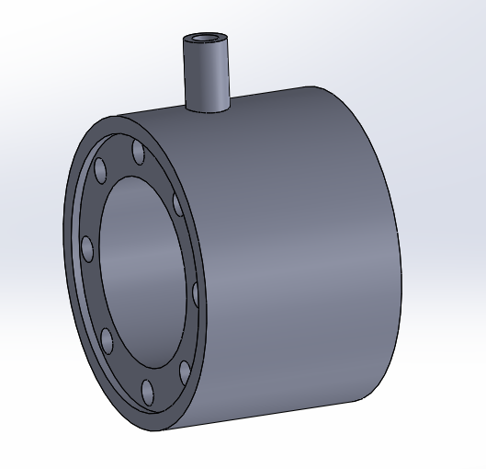
Air Bearings
Ideal solution: Frictionless air bearings
Prototyped several versions of ‘air pucks’ with different magnets
Various compliant materials to seal air bearing to the tablet
Notes:
Jose

Slide 34
Air Bearings
Issues:
Unable to develop an effective method of sealing/equally distributing the air
Would need to include the infrastructure/package a pump
Ultimately scrapped the idea
Notes:
Jose

Slide 35
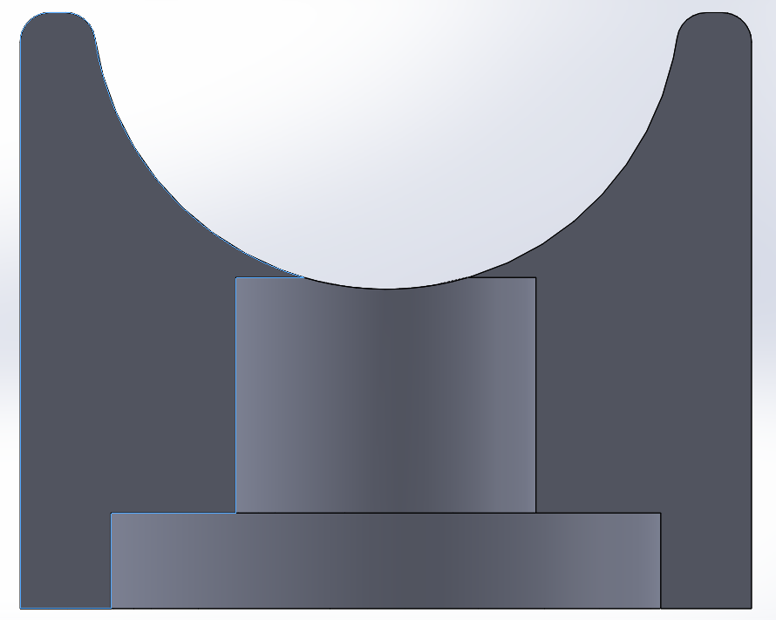
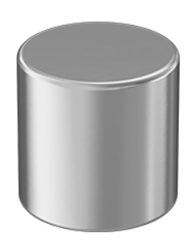
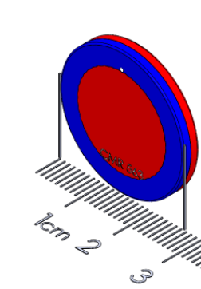
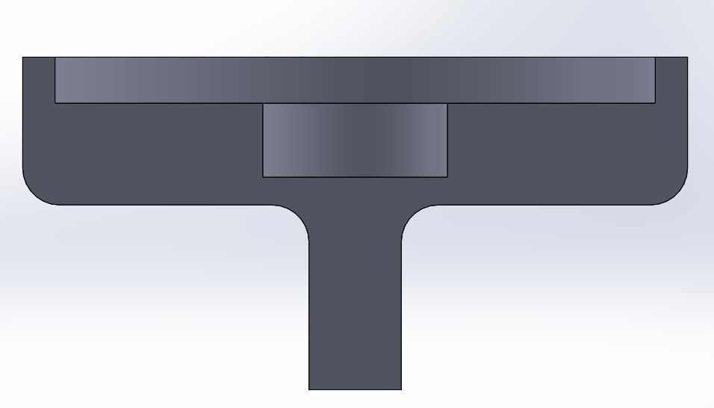
Current Design
The current design uses two different magnets:
Top magnet - ½ inch diameter neodymium magnet from McMaster - pulls 18lbs
Bottom magnet - 1 inch, ⅛ inch polymagnet
Together they give ~8N of shear strength with ~3N of friction
Requirements: >6N of shear strength
Notes:
Jose

Slide 36
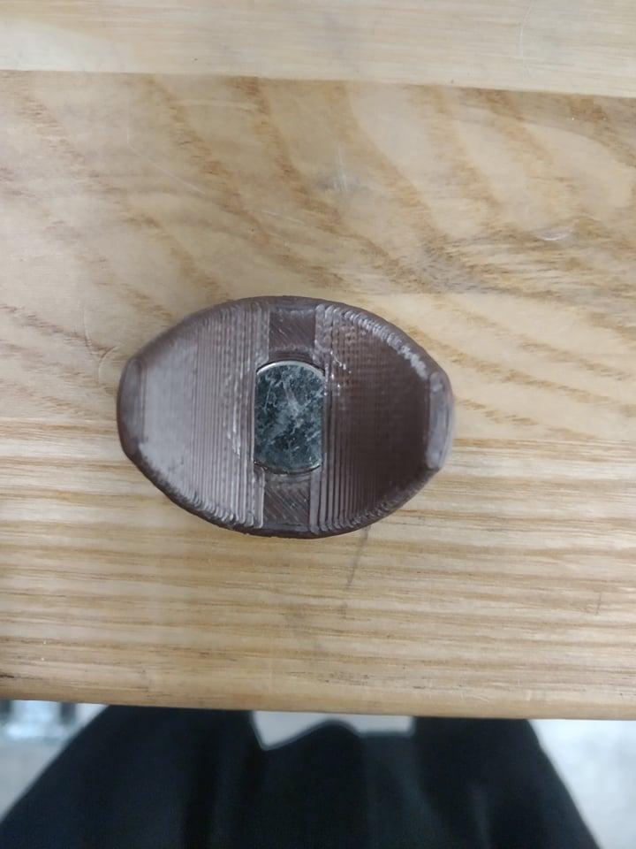
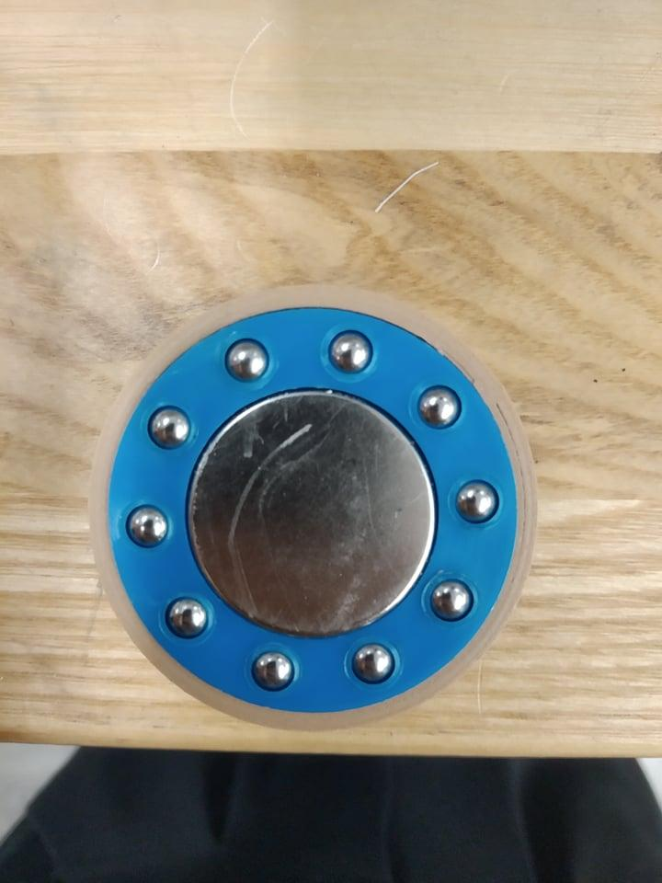
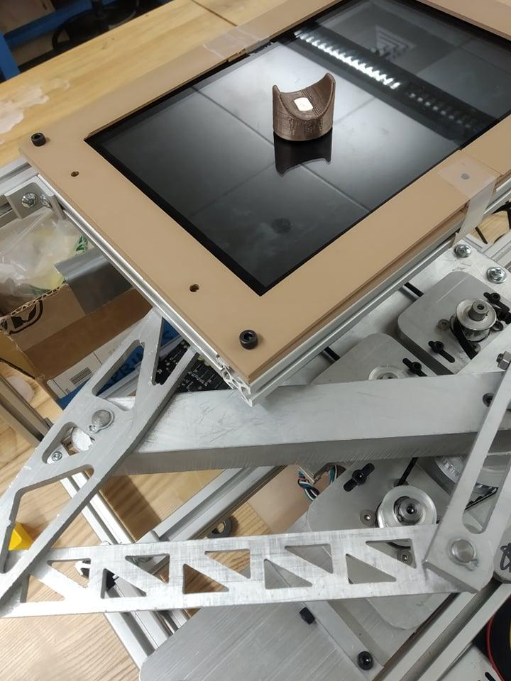
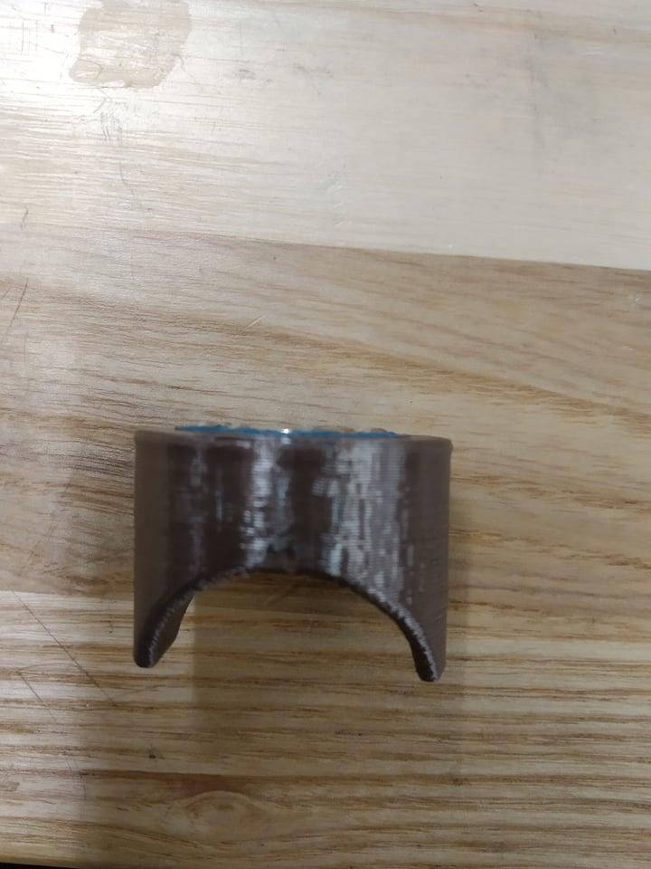
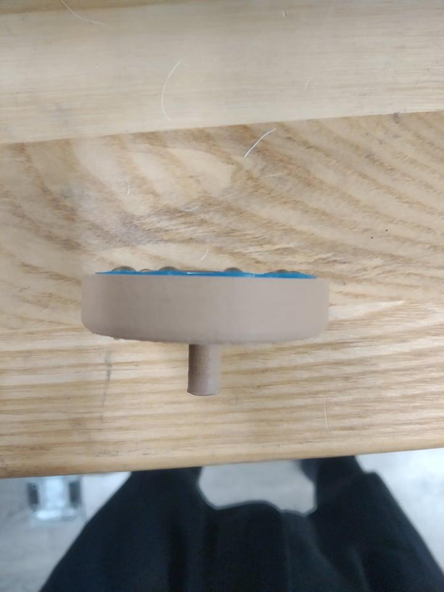
Current Design

Slide 37
Road Map
Process & Background
Technical Details
Demonstration
Beta Thoughts
Challenge Overview
Concept Phase
Testing Phase
Mechanical Design
Magnets
Electrical System
Control System
Notes:
Ray

Slide 38
Wire Diagram
Phase ABC
Phase ABC
Axis0
Axis1
Touchscreen
Motor
Gearbox
Motor
Gearbox
GND
FFC
FFC
Touch
sensor
HDMI
Driver
Power
Odrive
Encoder
Encoder
USB
HDMI
3.3V GND A B X
3.3V GND A B X
Nvidia Jetson Xavier NX
TX
RX
Power
RX
TX
Power Supply
GND
STM32
TX
GND
RX
Notes:
Ray

Slide 39
Communication
STM32 and Odrive -> UART(ASCII)
STM32 and Nvidia -> UART(ASCII)
Odrive and encoder -> SPI(Serial Peripheral Interface)
Nvidia and touch sensor -> I2C (Wire with USB)
Share GND to obtain right value
Notes:
Ray

Slide 40
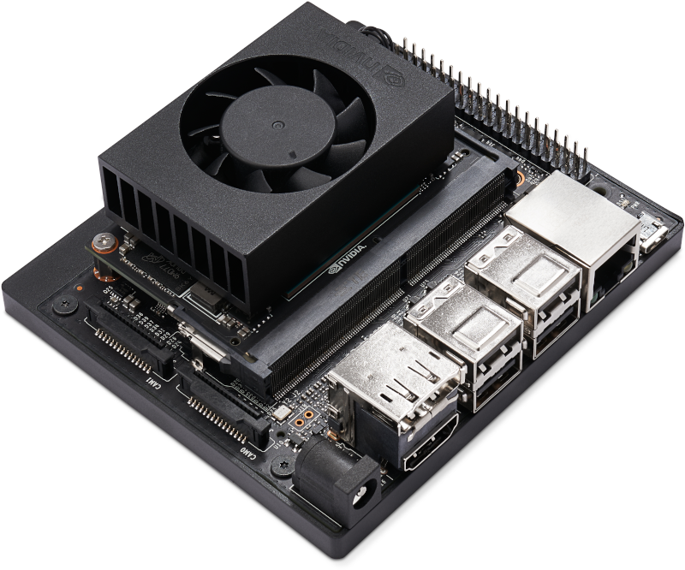
Key Component - Nvidia Jetson Xavier NX
Job
Linux system and drive the touchscreen
Mouse tracking
Send data to STM32
Technical specification
6-core NVIDIA Carmel ARM®v8.2 64-bit CPU
8 GB 128-bit LPDDR4x @ 51.2GB/s
GPIO, I2C, I2S, SPI, UART
Notes:
Ray

Slide 41
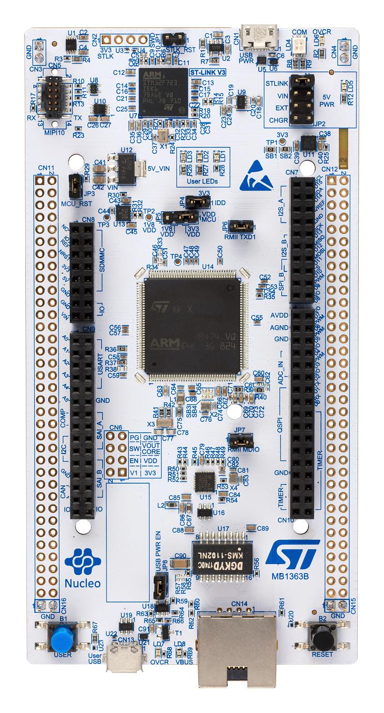
Key Component - STM32
STM32 and Odrive -> UART(ASCII)
Baud rate: 115200
Request position and velocity(unit in revolution)
Receive data and preprocess(offset elimination and reduction ratio calculation) to get actual angle.
Calculate position in 2D tablet and Jacobian
Determine the force act on end-effect and trans to torque with Jacobian
Send cmd to Odrive
500Hz
STM32 and Nvidia -> UART(ASCII)
Baud rate: 11520
Request touchscreen position
50Hz
Notes:
Ray

Slide 42
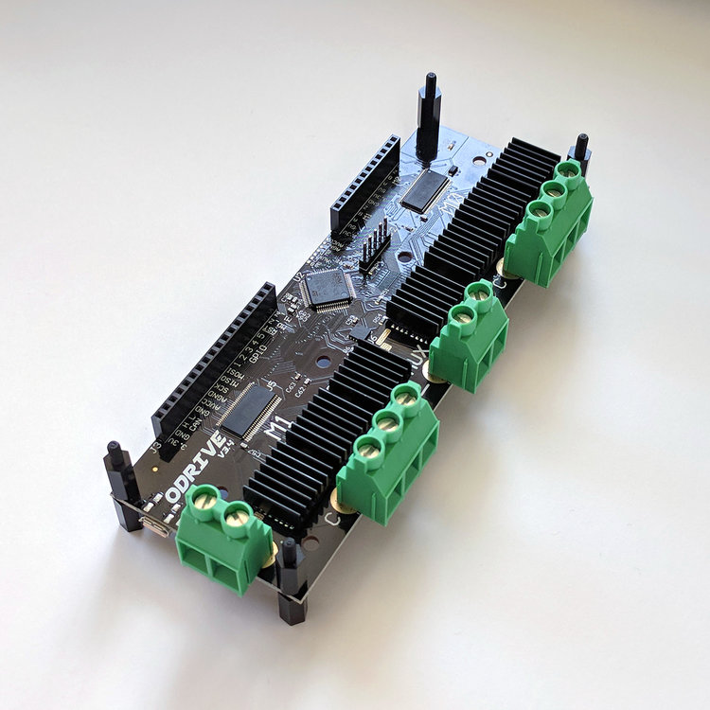
Key Component - Odrive
Python lib odrivetool
DC power voltage input range 12-56V
Peak current 120A per motor
UART communication
Position control and input torque
Notes:
Ray

Slide 43
Key Component - Odrive
Odrive calibration config
Odrv0.axis0.motor.config
Odrv0.axis0.controller.config
Odrv0.axis0.encoder.config
Difference between axis0(green) and axis1(pink)
Odrv0.axis0.controller.config.pos_gain = 100
Odrv0.axis1.controller.config.pos_gain = 200
Notes:
Ray

Slide 44
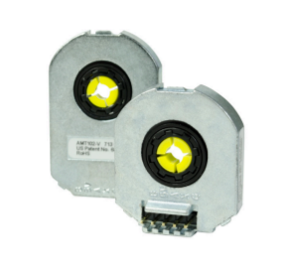

Key Component - Encoder
AMT102-V from CUI Devices
Quadrature resolutions 2048 PPR(Pulses Per Revolution)
Counts Per Revolution 2048*4
Creates linear resolution of 28 μm at end effector
Notes:
Ray

Slide 45

Key Component - Touchscreen
10” x 7” Display (1280*800 pixel)
Single point touchscreen
Run tablet off of Nvidia Jetson Xavier NX
Touch sensor with USB
Notes:
Ray

Slide 46

Key Component - Touchscreen
Using python lib pyautogui
Tracking mouse position
Return position values in pixel
Notes:
Ray

Slide 47
Touchscreen Issues
Problem #1
Raspberry Pi touchscreen only have single touch
Potential Solutions
Replace a conductive touch panel with multitouch
Add machine vision to track finger
Problem #2
Offset of the 2 phantom arm and the touchscreen need calibration
Potential Solutions
Set multipoint for calibration rather than limit switch and calculate the matrix
Notes:
Ray

Slide 48
Road Map
Process & Background
Technical Details
Demonstration
Beta Thoughts
Challenge Overview
Concept Phase
Testing Phase
Mechanical Design
Magnets
Electrical System
Control System
Notes:
Cam

Slide 49

Control System: Control Theory – Passive
Notes:
Cam

Slide 50

Control System: Control Theory – Active
Notes:
Lio

Slide 51

Control System: Control Theory – Active
Notes:
Lio

Slide 52

Control System: Control Theory – Calibration

Slide 53
Road Map
Process & Background
Technical Details
Demonstration
Beta Thoughts
Challenge Overview
Concept Phase
Testing Phase
Mechanical Design
Magnets
Electrical System
Control System
Notes:
Cam

Slide 54
Road Map
Process & Background
Technical Details
Demonstration
Beta Thoughts
Challenge Overview
Concept Phase
Testing Phase
Mechanical Design
Magnets
Electrical System
Control System
Notes:
Cam

Slide 55

Focus for Beta-Mechanical
Improve backdrivability
Slight redesign on Base Link shaft stack
Remake drive pulleys
Improve stiffness in the frame via gussets
Add acrylic guards to remove pinch points

Slide 56

Focus for Beta-Controls
Improved Wire Management
Continue to tune control algorithms
Aforementioned Touch Screen Issues:
Calibration
Multi-touch

Slide 57
Reference Slides
Motor and gearbox selection
Workspace plots
Condition number, resolution, backlash, output force, motor torque, reflected inertia

Slide 58

Motor Selection
BLY172D-24V-2000 from Anaheim Automation
Continuous torque: 0.2N-m
Torque constant: 0.055 N-m/A
Continuous speed: 2000 rpm
Motor inertia: 48.0 g-cm2
Notes:
Ray

Slide 59

Gearbox Selection
GBPS-0401-CS-005 from Anaheim Automation
Gear ratio: 5:1
Backlash: 0.1 degrees
Efficiency: 95%
Notes:
Ray

Slide 60

Condition Number Plot
*For right linkage

Slide 61

Resolution Plot
*For right linkage

Slide 62

Backlash Plot
*For right linkage

Slide 63
Force Plot
*For right linkage

Slide 64

Torque Plot
*For right linkage

Slide 65

Reflected Inertia Plot
*For right linkage

